Slide 1


WORLD CUP 2023 DATA ANALYSIS

Slide 2

Introduction
Exploring the cricketing brilliance of the prestigious World Cup tournament through comprehensive data analysis. Uncovering insights, trends, and performance dynamics to gain a deeper understanding of team and player contributions.

Slide 3


Dataset Overview
The dataset encompasses a wide range of features, including team, player, batting and bowling statistics, opposition details, ground information, and temporal aspects.
This comprehensive data coverage allows for a thorough and multifaceted analysis of team and player performances during the World Cup 2023 tournament.

Slide 4
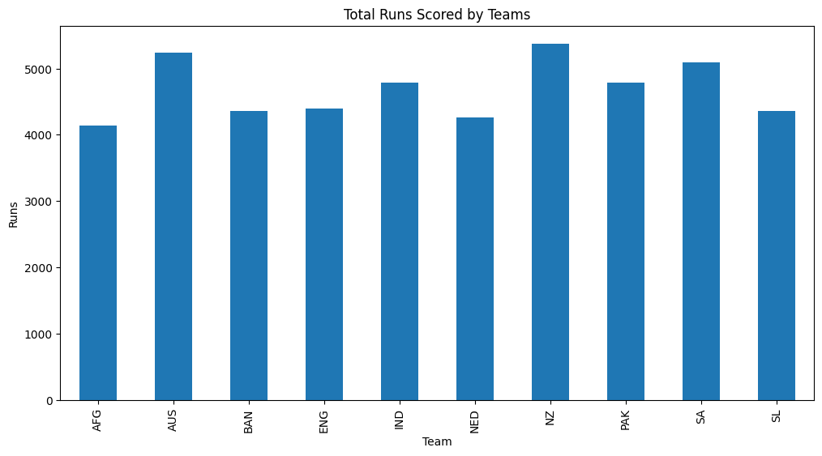
Visualizations - Team Performance

Slide 5
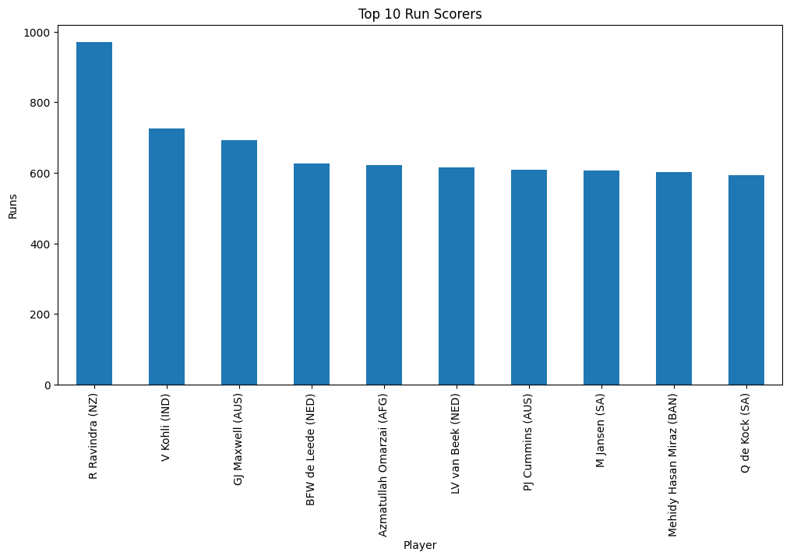
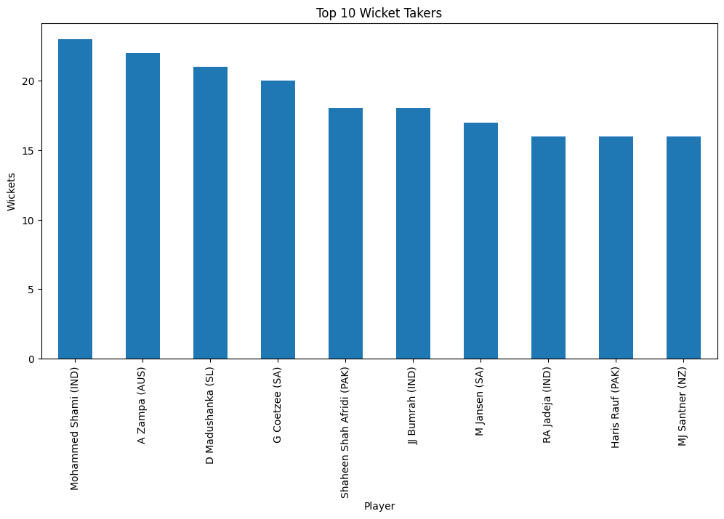
Player Performance Analysis

Slide 6
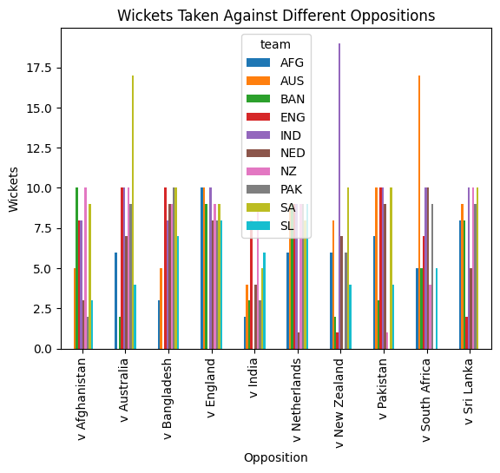
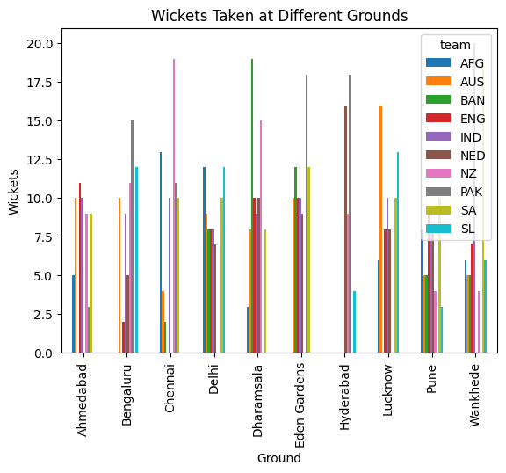
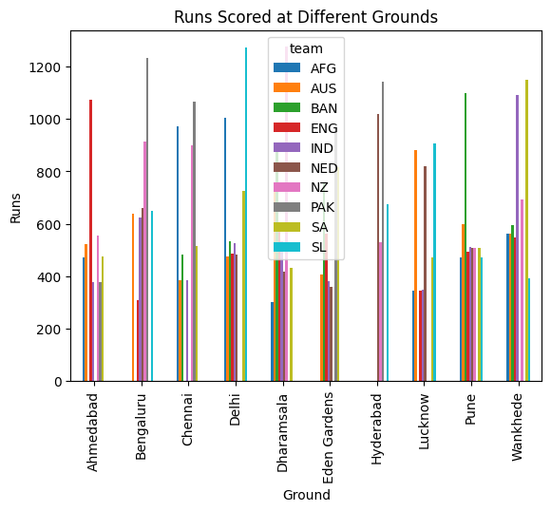
Opposition and Ground Analysis

Slide 7
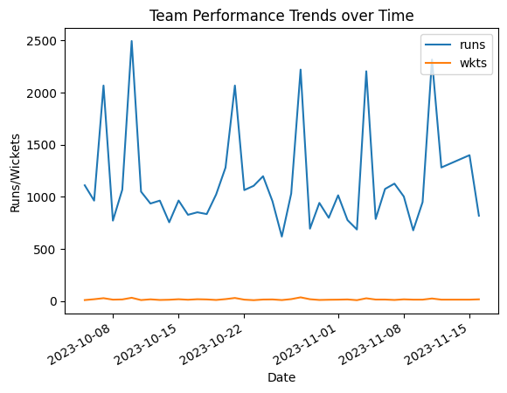
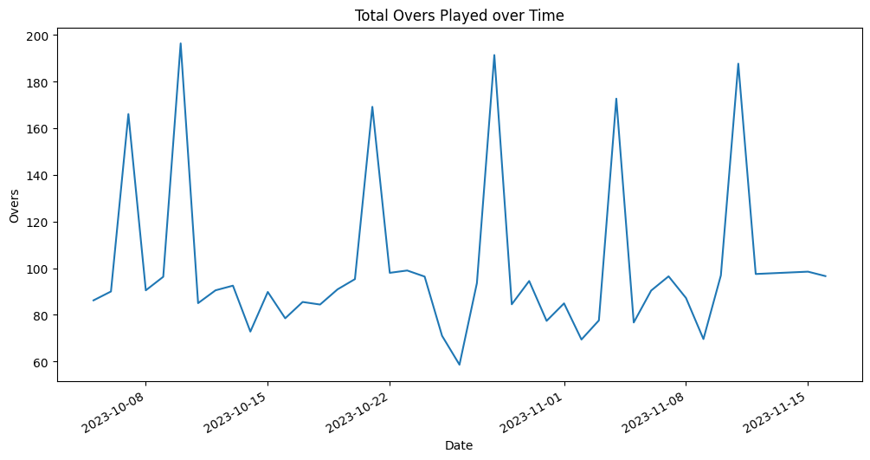
Temporal Analysis

Slide 8

Conclusion
Through the in-depth examination of team-level metrics, individual player statistics, opposition and ground-specific dynamics, as well as temporal trends, we have gained a deeper understanding of the factors that contributed to the success and challenges faced by the participating teams and players. The insights gleaned from this analysis can inform future strategy and decision-making for teams, coaches, and cricket governing bodies, ultimately enhancing the overall competitiveness and enjoyment of the sport. This project has demonstrated the power of data-driven analysis in unraveling the complexities of a dynamic and competitive sport like cricket, paving the way for further research and innovation in the field.

Slide 9


